Slide 1

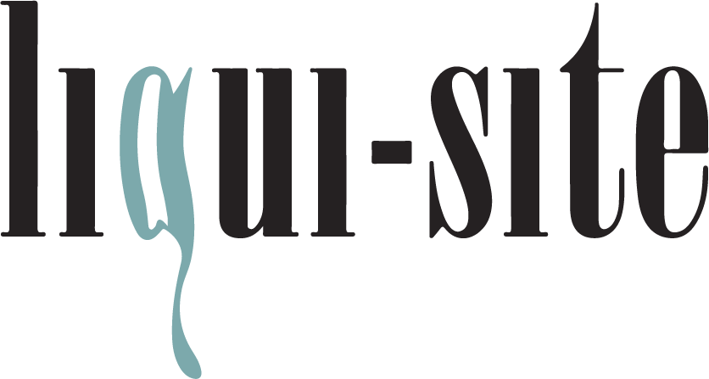
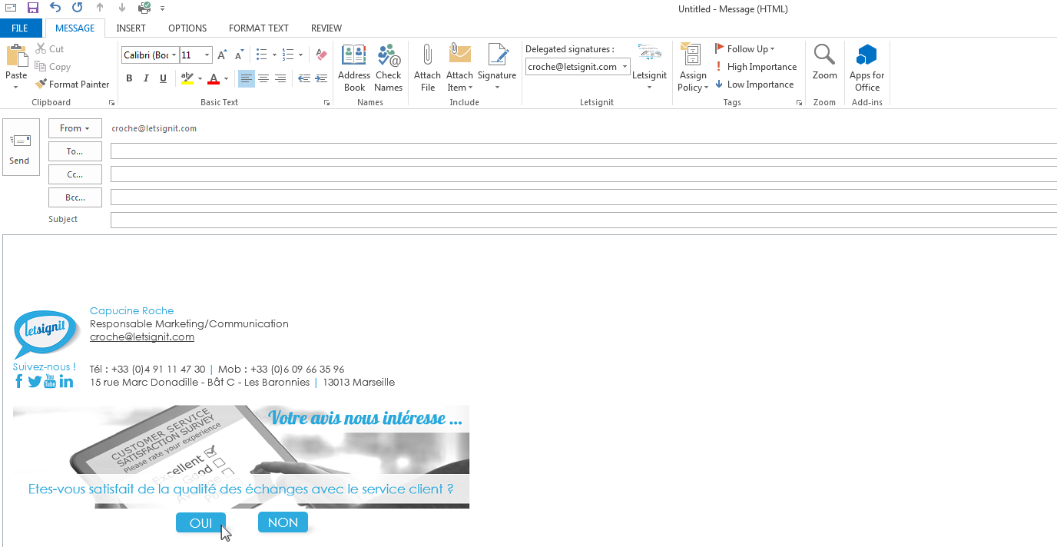
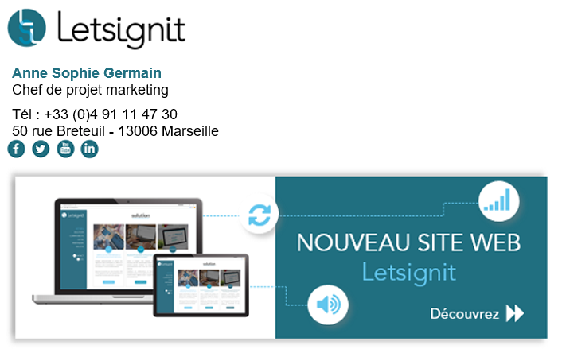

The 100% automated email signature solution
Dear Tom,
As agreed, here is an overview of our modules.
CENTRALIZE STANDARDIZE COMMUNICATE

Slide 2
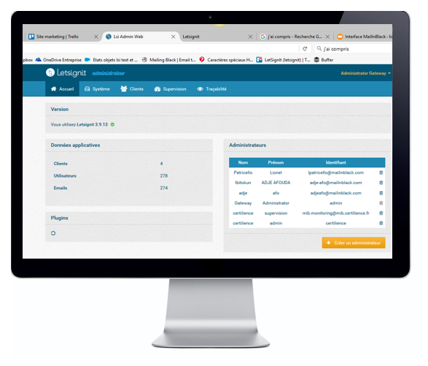











For IT
Centralize & control your email signatures
Make changes or updates to your employees’ email signatures in just a few clicks from a single administrator control panel.
It lets IT Departments to
SaaS and on-premise versions available; compatible with:
Our dedicated control panel for IT departments lets your IT professionals:
Import and synchronize Letsignit with your organization’s current databases (Azure AD, AD, csv, etc.).
Delegate signature management with restricted access by subsidiary, country, brand, etc.
Manage Letsignit implementation on user workstations regardless of the type of email client.
Benefits for IT departments
Automate your processes and free up time and resources currently spent managing signatures
Cover 100% of your organization’s needs with a single solution
Save time with a reliable, agile solution
Provide 100% of your users with mobile access with Letsignit’s optional outgoing SMTP feature!

Slide 3
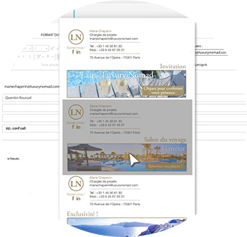
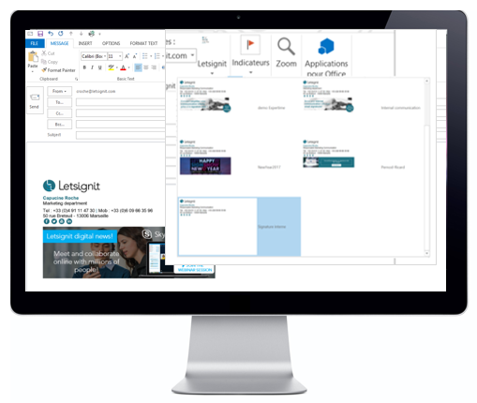
For employees
Simple & flexible
Make changes or updates to your employees’ email signatures in just a few clicks from a single administrator control panel.
It lets Users to
Users connect to the administration control panel managed by the IT department via a plug-in installed on their email clients so that they can:
Insert and update email signatures automatically.
Preview the signature before sending an email.
Automatically use in-house and external email banners according to the recipient’s email address.
Enjoy the flexibility of being able to use multiple signatures.
Benefits for employees
Save your users time they currently spend managing email signatures
Cover 100% of your users’ needs by giving them a flexible solution they can manage themselves
Boost employee engagement by leveraging email to share your organization’s latest news

Slide 4

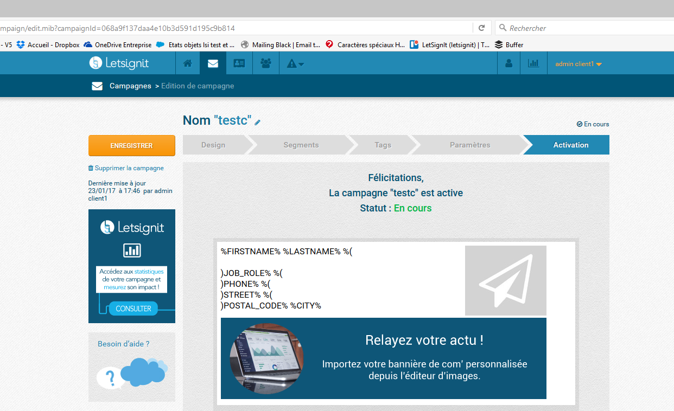
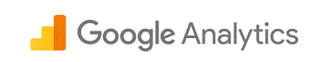

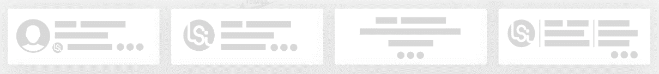


For marcomm
Standardize & boost the impact of your signatures
Roll out dynamic, controlled, and targeted
communications campaigns.
Inside your organization: Boost motivation and engagement.
Outside your organization: Reach out to a “captive” audience.
It lets Communication departments to
Compatible with:
Our functional control panel lets your communications department:
Create personalized signatures for specific groups of employees using an HTML editor or pre-designed templates.
Insert and schedule special signatures for use inside or outside your organization on specific dates.
Track the number of clicks and find out who clicked from a dedicated analytics dashboard.
Benefits for communications departments
Ensure a consistent brand identity by standardizing 100% of your signatures
Boost your employee and external communications by integrating dynamic banners into your signatures
Leverage your marketing databases and increase your return on investment

Slide 5


CASE STUDIES
< Company >
< Click rate >
< Open rate >
JCDecaux
3.6%
Campaign Performance with
Phone Régie
16.2%
100%
Urmet
8.6%
ExterionMedia
3.2%
Compared to typical email campaign performance:
2.7%
21.5%
One solution for all functions across your organization for greater returns on your investment!
Sales
IT & HR
Customer service
Communications
Social Media
Product launches
New features
Customer testimonials
Change management
Employee communications
New labor laws & regulations
Customer satisfaction surveys
New features
Tutorials
Newsletters
Webinars
Events
Facebook
Twitter
LinkedIn

Slide 6
SIGNATURE MODULES
PROFESSIONAL
CAMPAIGN
Access to a signature editor to create your signatures
Library of ready-to-use signature templates
Company logo (150 pixels max.) and/or social media icons
Hyperlinks
Personalized signatures by domain
Simple signature for replies and forwarding
Automated signature implementation and preview
PROFESSIONAL
+
CAMPAIGN
Automatic banner ad insertion
Scheduled banners for specific date ranges
Differentiated employee and external banners
Personalized banners for different user groups
Premium widgets (latest tweet, agenda, RSS feed, etc.)
No size limit on images
Link tracking
Analytics (mails sent, number of clicks, who clicked)
Click notifications
Exportable statistics on who clicked
Access to administration interface
Personalized signatures for configurable user groups (city, country, etc.)
Mobile/tablet coverage
Delegated, separate signature management (subsidiaries)
Synchronization with multiple databases (AD, Azure AD, csv, etc.)
Multi-signature management
Standardize email signatures with advanced features.
Standardize email signatures and extend the reach of employee and external communications campaigns.
Price : $1.30 per month/user
Price : $1.30 per month/user

Slide 7

Learn more: www.liqui-site.com

