Slide 1

From Concept to Conversions.
We are the SEO and WordPress Experts.
701 Grand St
Hoboken, NJ 07030
Liqui-site.com
(845) 353-7771

Slide 2






RESEARCH
BUILD
OPTIMIZE
MONITOR
ADJUST
Research market and your competitors, and listen to what you want to focus on.
Build quality links, citations, website, blog postings, sell sheets and ads
Optimize every detail of your website with the most relevant keywords and new contents
Keep track of the things we’ve done, analyze the results we have generated.
We’re right there with you constantly making educated adjustments so your business is never stale.
REPEAT
For over a decade, we have helped hundreds of clients secure top position on search engines.
We thrive on finding ways to help our clients develop new business
and operate more efficiently in order increase productivity and profitability.

Slide 3


eSignit
For IT
For Employees
For Marketing
Centralize & control your email signatures
Make changes or updates to your employees’ email signatures in just a few clicks from a single administrator control panel.
Simple & flexible
With 100% automated email signature management, simply implement your employees’ signatures for them and they are ready to go.
Standardize & boost
the impact of your signatures.
Roll out dynamic, controlled, and targeted
communications campaigns.
Benefits for IT departments
Automate your process and free up time and resources currently spent managing signatures.
Cover 100% of your organization’s needs with a single solution.
Save time with a reliable, agile solution.
Benefits for users
Save your users time they currently spend managing email signatures
Cover 100% of your users’ needs by giving them a flexible solution they can manage themselves.
Boost employee engagement by leveraging email to share your organization’s latest news.
Benefits for communication departments
Ensure a consistent brand identity by standardizing 100% of your signatures.
Boost communications by integrating dynamic banners into your signatures.
Leverage your marketing databases and increase your return on investment.

Slide 4


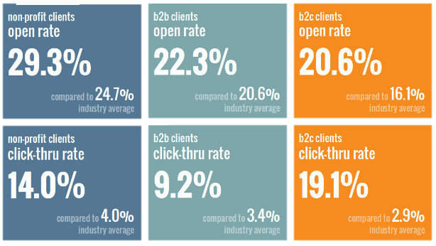



Email Marketing
01 CREATION
Template design
Include on-brand graphics
Strategic, actionable content
Fully responsive and optimized for mobile and everything
We pull out all the stops to make sure we’ve crafted a responsive email campaign that customers respond to, more than the industry average
02 AUTOMATION
Generate address list
Date-specific promos, drip campaigns, workflow triggered emails, and everything
Automatically deliver new blog contents
03 REPORT
A/B testing
Data tracking and analysis
Comprehensive analytics reporting so that we can review together and determine next steps
04 RESULT
Increase operational efficiency with email automation
Save your marketing team’s time
Avoid shuddering spam folder

Slide 5




SEO Audit
01 RESEARCH
Perform an in-depth key phrase analysis that helps guide all SEO efforts.
Research the competitive landscape through major search engines to determine efforts required to achieve top natural rankings.
Review with client to ensure all key search items to be targeted are included.
02 IMPLEMENT
Copywriting of page titles and meta descriptions, married with 1-2 targeted key phrases per content page or post.
On-page SEO implementation of all applicable elements, including SEO-friendly URLs, image ALT and title tags, cross linking, headings, page titles, meta descriptions, etc.
03 OPTIMIZE WEBSITE
Improve website performance and speed, including all necessary compression and modification.
Add WordPress plug-in as necessary.
Implement 301 redirects for all existing URLs (content pages and blog posts) from the previous site to the new site preserve ‘link juice’.
04 RESULT
Our ongoing SEO solutions will allow you to see your site moving its way up the Google and other search engine ranking.
We use only the best, up-to-date ‘white-hat’ strategies to make sure that when you reach Page 1, you stay there – making your website a long-standing authority in your space.

Slide 6





Custom Web Design
With more people on their phones than ever before, your website needs to function across all devices—from desktops and laptops to smartphones and tablets. Using responsive web design techniques, we build you a visually stunning, compelling website that knows the device a user is on—and adapts to fit the screen
Responsive
Web Design
Content Management &
Web Development
We marry custom web design with custom web development for a truly seamless user experience. With robust yet easy-to-use content management systems, Liqui-Site provides a powerful foundation for all the functions you might need “behind the scenes”.
Hassle-Free CMS
Management and Security
Custom WordPress
Development
WordPress is a robust and formidable content management system (CMS), with search-boosting speed and a range of plug-ins. Our innovative development team makes it entirely yours. Unlike others, we eschew templates and prefabricated themes to produce and program your site from scratch. When we say ‘custom,’ we mean it.
WordPress is also one of the most user-friendly content management systems around. That means your team can publish content quickly. Better yet, if your site is hosted with us, we handle all core and non-core updates for your CMS and plug-ins. To protect your site from issues and vulnerabilities, we apply updates in a staging environment before pushing them live.

Slide 7



White Papers
EXAMPLE
WHITE PAPERS
BENEFITS
Long-form content designed to promote the products or services from a specific company.
As a marketing tool, these papers use selected facts and logical arguments to build a case favorable to the company sponsoring the document.
Attract decision makers and set you apart from the competition.
68% of B2B marketing teams create eBooks for lead generation because they are a great way to familiarize buyers with the details of a product or prime a lead for purchase.
WE CAN OFFER
Whether you’ve already developed copy or you’re starting from scratch, we’re here to help you write or design an eBook that will serve as an effective part of your sales funnel.

Slide 8




PPC (pay-per-click)
Investigate
Create
Afterwards, we provide detailed reporting that assesses the performance of the campaign as a whole as well as your return-on-investment
Negative keywords we want to avoid
The copy and creative
Competitors (what is there ad spend? What do there ads look like?)
Come up with creatives based on your budget
Help craft the perfect SEM (search engine marketing) and PPC (pay per click) campaign
Get the extra boost whether you are looking to climb the organic ranks quicker, or just continue to make impressions and ensure you are found more easily
Analyze
Empower

Slide 9






RTB (Real-Time-Bidding)
02
PLANNING
Design the ad creative based on our research
Budget the campaign
Optimize bids
Manage the ad spend
Make contact through our software that reaches 98%of all websites.
01
TARGETING
03
TRACKING
Research optimal target for a specific campaign
Learn the audiences purchasing behavior
Nearly everything is targetable – geographic location, job title, household income, age, etc.
Once a visitor hits your site, we track that user or shopper, and track them indefinitely for pennies using our retargeting ads
Easily able to remove the tracking as soon as they convert after submitting a form or make a purchase
“ Fine tune your marketing spend on the few people that are the exact target market you are looking for! ”

Slide 10
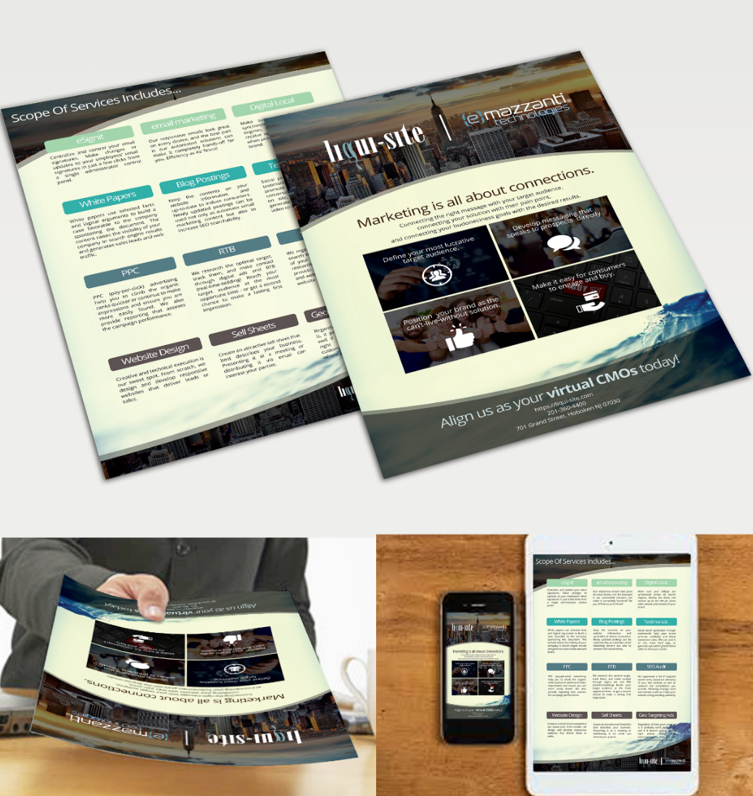


Custom Sell Sheet
EXAMPLE
BENEFITS
The best way to generate interest and grab attention in your product or service.
Well-made sell sheet delivers a perfect pitch every time - It promotes your business without you needing to be physically present.
WHAT WE CAN DO
Have a well-designed, customized sell sheet only for you, and facilitate your corporate image
Develop strong concept presentations, which includes visual branding, integrative marketing and effective communication techniques
Can be formatted in a variety of ways – both online and offline, and are unique to your company’s needs.

Slide 11
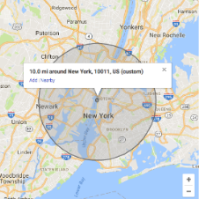



Geo-Targeting
GEO-TARGETING IS
Geographic targeting, also known as geo-targeting, allows you to pick and choose where to place your ads based on zip code, place of interest, tourist destination, countries, and more.
BENEFITS
Targeting ads to a precise location helps you reach audiences of different demographics, interests, and income levels.
Create brand awareness for your company in places where your customers will be. Not able to attend a trade show, but want to target the attendees? Geo-targeting makes it easy!
Choose what messaging send different messages to people based on their geographic location.
Personalize your ad copy by using the names of the cities and towns you’re targeting for higher conversion rate opportunities.
WHERE CAN WE TARGET
States, cities, tourist hot spots
Countries
Mass transit hubs, shopping
centers, theaters, and
recreational locations
Trade shows & convention centers, hotels, business spaces and buildings

Slide 12
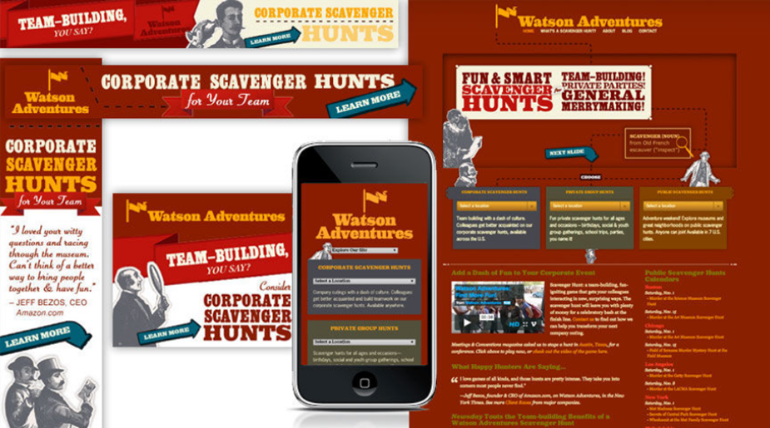
CASE STUDY
37%
Organic search
56%
Corporate Leads
30%
Leads Increase
20%
Revenue Increase
CUSTOMER REVIEW
CHALLENGE
OUR SOLUTION
We've received very positive feedback on the site, and the number of visitors has increased significantly. Their responsiveness has been phenomenal. Liqui-Site adds a considerable amount of value that goes well beyond the scope of the contract.“
- Lucy Redzeposki, Director of Economic Growth, County of Rockland
Their previous web development company had not optimized the site for organic search
Popular pages were not redirecting properly
On mobile devices, the site left users hunting for a better brand experience.
Identified target search terms for public, private and corporate hunts
Optimized the top 50 pages from every angle. developed a custom SEO plug-in to provide complete control over existing (and new) location pages
Launched the fully responsive version
Ran SEM campaigns.

